Slide 1




Eegai Inidhu Trust
“Transforming Lives. Strengthening Communities. Sustaining Our Earth”
+91-72000 72711
dhanab@eegaiinidhu.com
eegaiinidhu.com
5th Floor, Murugesan Naicker Complex, No.84, Greams Rd, B-Block, , Thousand Lights, Chennai, Tamil Nadu, 600006.
EEGAI INIDHU TRUST

Slide 2
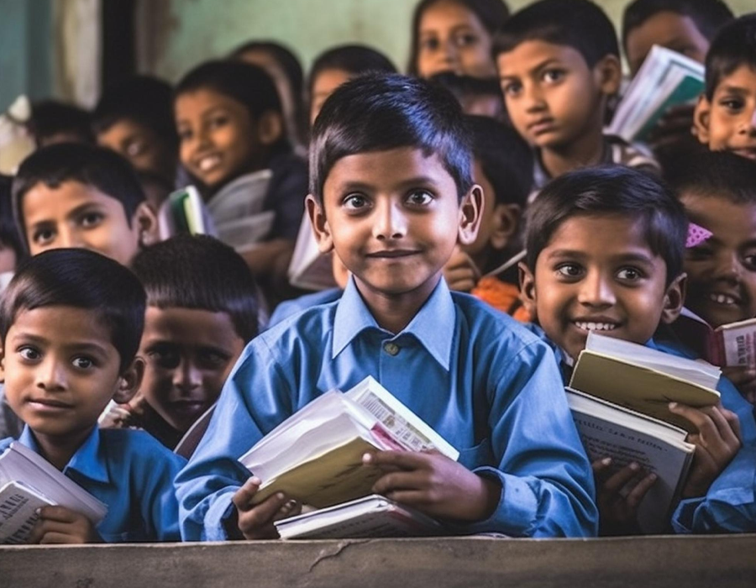
Eegai Inidhu Trust
Eegai Inidhu Trust (EI), is deeply committed to the mission of transforming lives and fostering sustainable communities. Our organization is dedicated to the holistic development of marginalized and underprivileged communities, focusing on education, empowerment, dignity restoration, and environmental sustainability.
We believe in the power of collective action and generosity, embodied in our philosophy of "The Joy of Giving." Through our initiatives, we aim to nurture future leaders, rehabilitate vulnerable individuals, and restore ecological balance. Our work is driven by the vision of a healthier, happier, and more sustainable society, where every effort creates lasting, positive change.

Slide 3



Problem Statements
Lack of Access to Quality Education
Children from marginalized communities lack access to quality education, digital literacy, and life skills, hindering their future prospects and personal development.
Substance Addiction Among Youth
Youth, particularly adolescents, face high rates of substance addiction, with limited rehabilitation programs to help them recover and reintegrate into society.
Environmental Degradation
Unemployment and Skill Gaps
Waste Management Issues
Urbanization and deforestation are causing the depletion of natural resources, and there is insufficient community-led action to restore and protect the environment.
Rehabilitated individuals, especially those overcoming addiction, struggle with unemployment and lack access to skill development programs to rebuild their careers and secure stable livelihoods.
Ineffective waste management systems in urban and rural areas contribute to pollution, overflowing landfills, and a lack of public awareness on sustainable practices like recycling and composting.

Slide 4
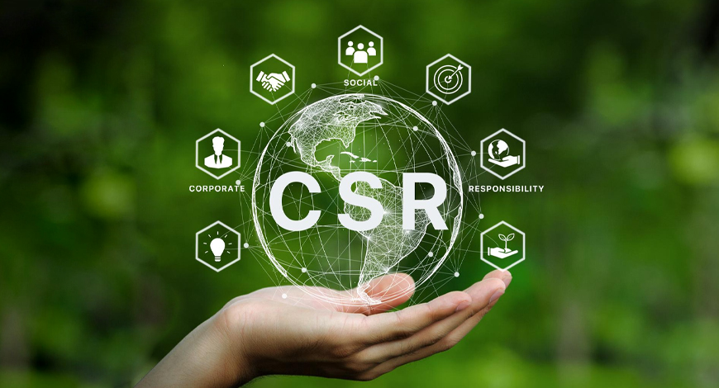
Solutions We Offer
Empowerment through Green Livelihoods
EI trains women and youth in sustainable waste management and green entrepreneurship, offering micro-grants and support to establish self-sustaining businesses.
Quality Education Access
EI offers free tuition, scholarships, and coaching to ensure underprivileged children and youth gain access to quality education, digital literacy, and life skills.
Rehabilitation and Skill Development
EI partners with rehabilitation centers to provide counselling, skill development, and livelihood support, helping individuals overcome addiction and rebuild their lives.
Environmental Restoration and Sustainability
EI initiates programs like Palmyra restoration and zero-waste communities to promote sustainability and create eco-friendly livelihoods within local communities.

Slide 5
Unique Selling Points
Holistic Development Approach
EI integrates education, livelihood, health, and environmental sustainability into one cohesive strategy, ensuring comprehensive community development.
Community Ownership & Sustainability
Strategic Alignment with Corporate CSR Goals
Transparency & Accountability
EI fosters grassroots engagement, ensuring that initiatives are self-sustaining and continue beyond the funding cycle through community involvement.
EI’s programs align with corporate CSR objectives and UN SDGs, enabling measurable impact in education, gender equality, climate action, and sustainable development.
EI upholds high standards of transparency and accountability with robust monitoring, reporting mechanisms, and creative storytelling to highlight CSR impact.
Anytime, Anywhere

Slide 6
Market Opportunity
NGOs and charitable organizations
The Indian NGOs and charitable organizations market is projected to reach USD 464.86 billion in 2025, up from USD 425.77 billion in 2024, reflecting a steady growth trajectory.
TAM
USD 464.86 Bn
NGOs and charitable organizations
#Target Market
SAM
US$ 92.97 Bn
  Underprivileged Children
  Youth & Women in Rural Areas
  Addiction Recovery Seekers
  Local Communities Focused on Sustainability
  Corporates & Institutions for Partnerships
  Government and Educational Bodies
SOM
US$ 18.59 Bn

Slide 7


Revenue Model
Donations and Sponsorships
  Eegai Inidhu Trust generates revenue through donations from individuals, corporate sponsors, and philanthropic organizations. This includes funding for scholarships, rehabilitation programs, skill development, and environmental sustainability projects.
Partnerships and Collaborations
  EI partners with de-addiction centers, educational institutions, and local governments to secure funding and resources. Revenue is also generated through partnerships with farmers and palm tree cultivation initiatives, with a focus on sustainable livelihoods and eco-friendly products.

Slide 8




Go To Market Strategy
Community Engagement & Partnerships
Foster local partnerships with schools, rehab centers, and government bodies to raise awareness and drive support for EI’s educational, rehabilitation, and environmental initiatives.
Corporate CSR Collaboration
Collaborate with corporations on CSR projects that focus on education, gender equality, and sustainability, creating impactful joint initiatives to drive measurable change.
Digital & Social Media Outreach
Utilize social media and EI’s website to highlight success stories and real-time updates, attracting donors, volunteers, and advocates to support EI’s mission.
Government Scheme Alignment
Leverage government schemes like Swachh Bharat and TNUIFSL to secure funding, enhancing EI’s involvement in sustainable development projects across Tamil Nadu.

Slide 9
From Vision to Victory
Our Roadmap
Enhance partnerships with rehabilitation centers and expand skill development and livelihood support for rehabilitated individuals.
Build more corporate CSR collaborations to secure funding for sustainable development initiatives and increase impact.
Expand Educational
Initiatives
Broaden Environmental Projects
Increase Community Engagement
Phase 1
Phase 3
Phase 5
Phase 2
Strengthen Rehabilitation Programs
Phase 4
Leverage Corporate Partnerships
Increase the number of tuition centers and scholarship programs to reach more underprivileged students across Tamil Nadu.
Scale up the Palmyra restoration project and establish additional Zero Waste Community Hubs across urban and rural areas.
Strengthen grassroots engagement with local communities to ensure sustainability and long-term ownership of EI’s programs.

Slide 10








SWOT Analysis
STRENGTHS
WEAKNESSES
OPPORTUNITIES
THREAT
EI’s holistic development approach effectively integrates education, health, livelihood, and environmental sustainability to create long-lasting community impact.
EI’s reliance on external funding and partnerships limits scalability and expansion beyond Tamil Nadu.
Increasing demand for CSR collaborations and government support provides a chance to expand outreach and impact nationally.
Economic fluctuations and competition from other NGOs could challenge funding and resource acquisition.

Slide 11
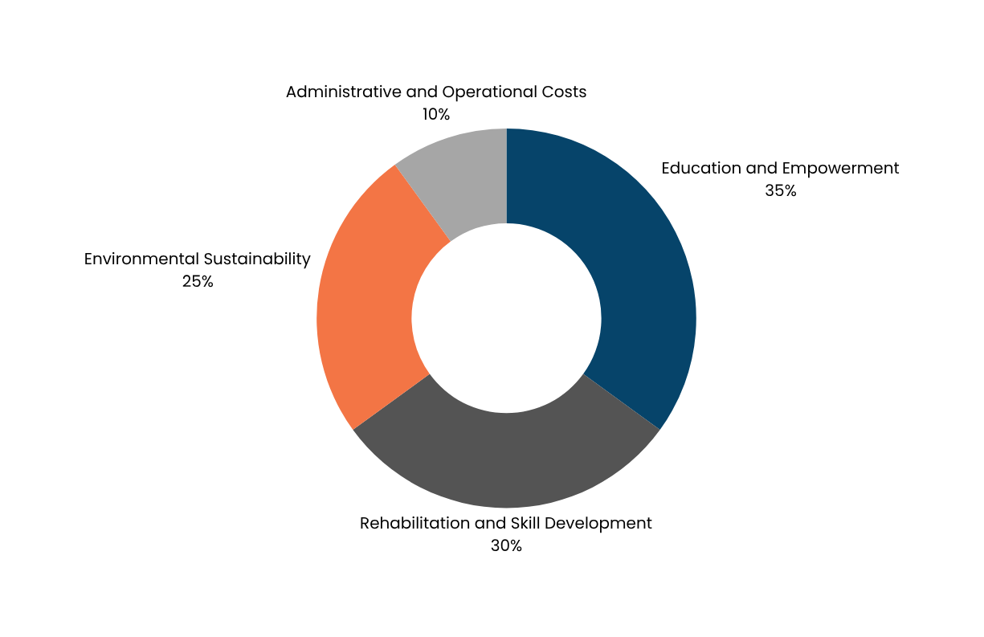
Fund Ask
OUR
ASK
Need of the hour
Eegai Inidhu Trust (EI) needs to secure sustainable funding to expand its educational and environmental initiatives nationwide. Strengthening partnerships with corporates, government bodies, and communities is crucial for broader impact.
Expanding digital outreach will help increase awareness and engagement from donors and volunteers. Additionally, enhancing operational efficiency and capacity building will ensure the long-term sustainability and growth of the programs.

Slide 12
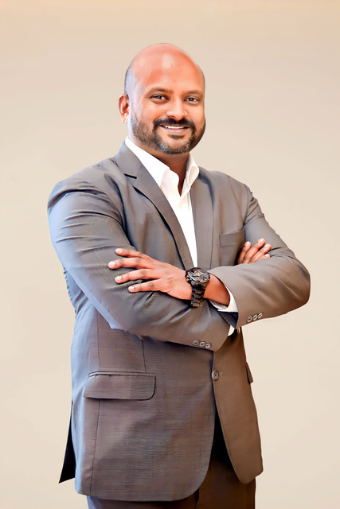
Key Person
Dr. Dhanasekar. B
Managing Trustee
Dr. Dhanasekar B, Director of Eegai Inidhu Trust, brings over 22 years of experience in Human Resources and organizational development. With an MBA in HR, he is deeply committed to empowering communities through education, skill development, and rehabilitation.
His leadership focuses on fostering strategic partnerships to expand the Trust's reach and impact. Dr. Dhanasekar's vision is to create sustainable change by addressing the social, economic, and emotional needs of marginalized families.

